Slide 1



Computer Vision
Introduction to Digital Image Processing
Dr. Anjali Diwan
Department of Computer Engineering

Slide 2

What is Digital Image?
A digital image is a representation of a two-dimensional image as a finite set of digital values, called picture elements or pixels

Slide 3
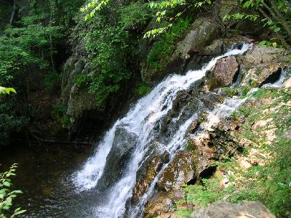
What is Digital Image? (Cont.)
Common image formats include:
1 sample per point (B&W and Grayscale)
3 samples per point (Red, Green, and Blue)
For most of this course we will focus on grey-scale images

Slide 4
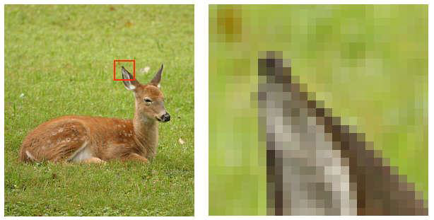
What is Digital Image? (Cont.)
Pixels: Elements of the digital image , each has intensity.
Intensity of pixel: the amplitude of gray level (in gray scale images)

Slide 5
What is Digital Image? (Cont.)
An image can be defined as function of 2 variables , f(x,y), where x and y are spatial coordinates, and the amplitude of f at any pair of coordinates (x , y) is called the intensity of the image at that point

Slide 6
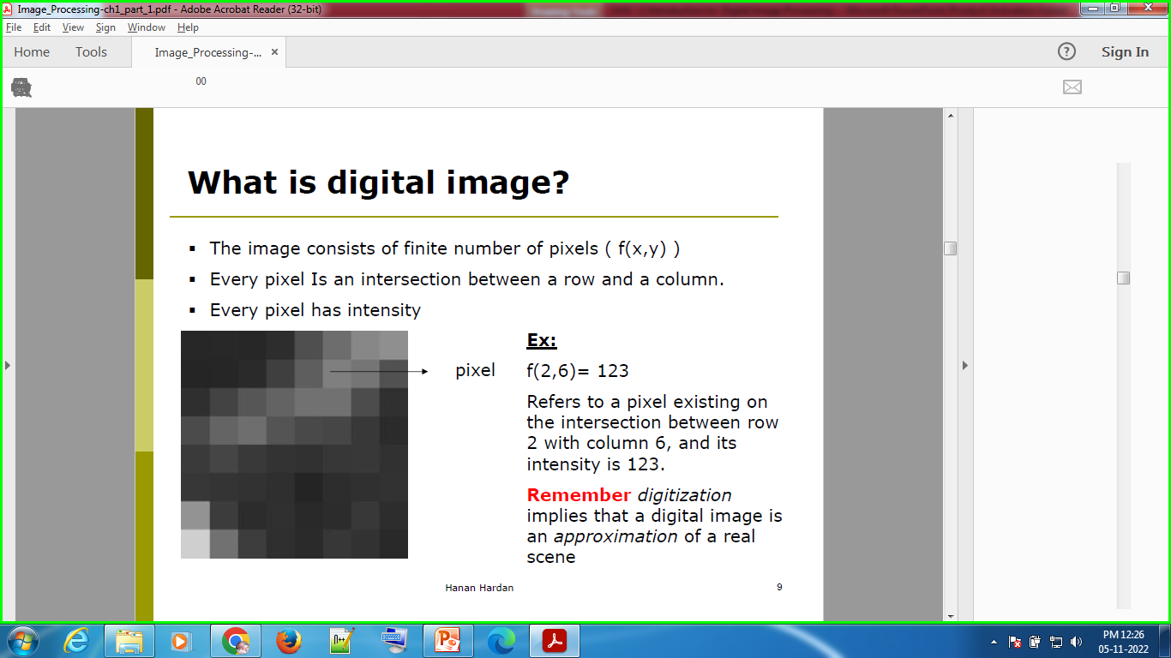
What is Digital Image? (Cont.)
The image consists of finite number of pixels (f(x,y) )
Every pixel Is an intersection between a row and a column.
Every pixel has intensity

Slide 7
What is Digital Image? (Cont.)
Digital image processing focuses on two major tasks
Improvement of pictorial information for human interpretation
Processing of image data for storage, transmission and representation for autonomous machine perception

Slide 8
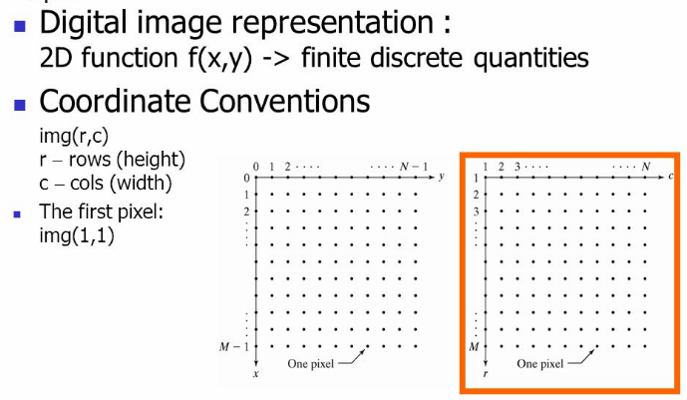
What is Digital Image? (Cont.)

Slide 9
Pixel
Pixel is the smallest element of an image. Each pixel correspond to any one value.
The value of a pixel at any point correspond to the intensity of the light photons striking at that point.
Each pixel store a value proportional to the light intensity at that particular location.

Slide 10
Calculation of total number of pixels
We have define an image as a two dimensional signal or matrix.
Then in that case the number of Pixel would be equal to the number of rows multiply with number of columns.
This can be mathematically represented as below:
Total No. of pixels = No. of rows * No. of columns

Slide 11
Calculation of total number of pixels (Cont.)
Total No. of pixels = No. of rows * No. of columns = 3 X 3 = 9.
It means that an image would be formed with 9 pixels,
0 | 0 | 0
0 | 0 | 0
0 | 0 | 0

Slide 12
What Is Image Processing?
Image processing is the process of transforming an image into a digital form and performing certain operations to get some useful information from it.
We can also say that it is a use of computer algorithms, in order to get enhanced image either to extract some useful information.
The image processing system usually treats all images as 2D signals when applying certain predetermined signal processing methods.

Slide 13
What Is Image Processing? (Cont.)
Image processing mainly include the following steps:
Importing the image via image acquisition tools;
Analysing and manipulating the image;
Output in which result can be altered image or a report which is based on analysing that image.

Slide 14
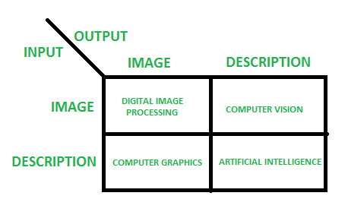
Overlapping Fields With Image Processing
According to block 1,if input is an image and we get out image as a output, then it is termed as Digital Image Processing.
According to block 2,if input is an image and we get some kind of information or description as a output, then it is termed as Computer Vision.
According to block 3,if input is some description or code and we get image as an output, then it is termed as Computer Graphics.
According to block 4,if input is description or some keywords or some code and we get description or some keywords as a output, then it is termed as Artificial Intelligence

Slide 15
Levels of Digital Image Processing
The continuum from image processing to computer vision can be broken up into low-, mid- and high-level processes
Low Level Process
Mid Level Process
High Level Process
Input: Image Output: Image
Examples: Noise removal, image sharpening
Input: Image Output: Attributes
Examples: Object recognition, segmentation
Input: Attributes Output: Understanding
Examples: Scene understanding, autonomous navigation

Slide 16
Levels of Digital Image Processing (Cont.)
low level processes:
Input and output are images
Tasks: Primitive operations, such as, image processing to reduce noise, contrast enhancement and image sharpening

Slide 17
Levels of Digital Image Processing (Cont.)
Mid-Level Processes:
Inputs, generally, are images.
Outputs are attributes extracted from those images (edges, contours, identity of individual objects)
Tasks:
Segmentation (partitioning an image into regions or objects)
Description of those objects to reduce them to a form suitable for computer processing
Classifications (recognition) of objects

Slide 18
Levels of Digital Image Processing (Cont.)
High-Level Processes
Input: Attributes
Output: Understanding
Tasks: recognizing objects
Image analysis and computer vision(Analysis of the image content)
Examples: Scene understanding

Slide 19
Application Fields of image Processing
Image Enhancement
The Hubble Telescope
Artistic Effects
Medicine
Geographic Information Systems
Industrial Inspection
Printed Circuit Board (PCB) inspection
Law Enforcement
Human Computer interfaces

Slide 20
Application Fields of image Processing (Cont.)
Automobile driver assistance
Lane departure warning
Adaptive cruise control
Obstacle warning
Digital Photography
Image Enhancement
Compression
Color manipulation
Image editing
Digital cameras
Sports analysis
sports refereeing and commentary
3D visualization and tracking sports actions

Slide 21
Application Fields of image Processing (Cont.)
Film and Video
Editing
Special effects
Image Database
Content based image retrieval
visual search of products
Face recognition
Industrial Automation and Inspection
vision-guided robotics
Inspection systems
Medical and Biomedical
Surgical assistance
Sensor fusion
Vision based diagnosis
Astronomy
Astronomical Image Enhancement
Chemical/Spectral Analysis

Slide 22
Application Fields of image Processing (Cont.)
Arial Photography
Image Enhancement
Missile Guidance
Geological Mapping
Robotics
Autonomous Vehicles
Security and Safety
Biometry verification (face, iris)
Surveillance (fences, swimming pools)
Military
Tracking and localizing
Detection
Missile guidance
Traffic and Road Monitoring
Traffic monitoring
Adaptive traffic lights

Slide 23
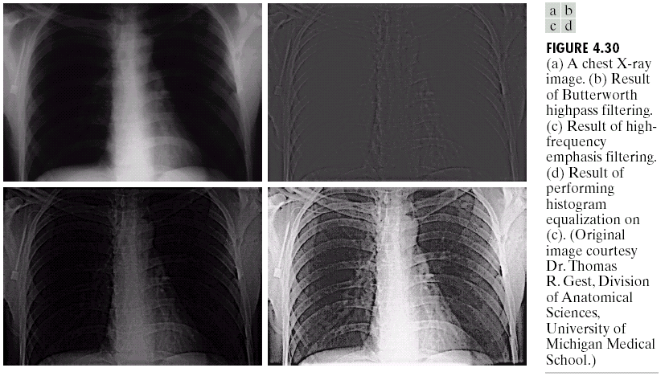
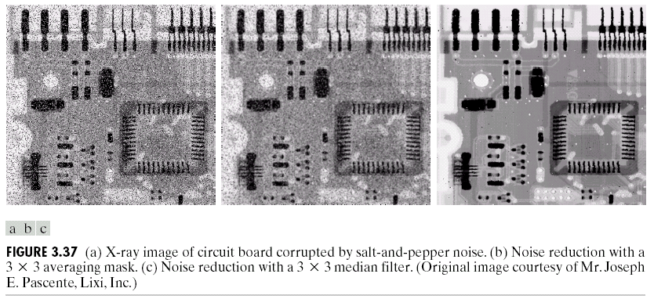
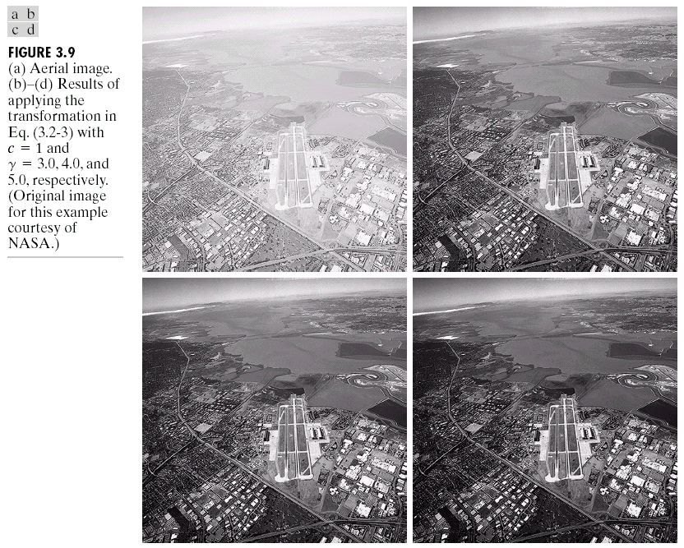
Examples: Image Enhancement
One of the most common uses of DIP techniques: improve quality, remove noise etc

Slide 24
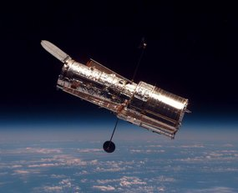
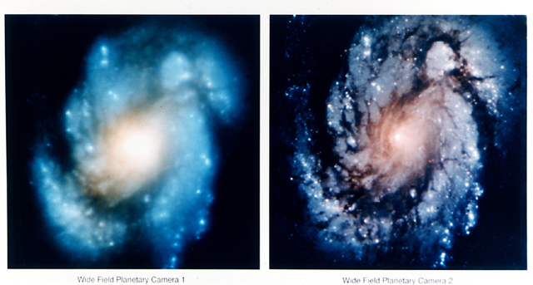
Examples: The Hubble Telescope
Launched in 1990 the Hubble telescope can take images of very distant objects
However, an incorrect mirror made many of Hubble’s images useless
Image processing techniques were used to fix this

Slide 25
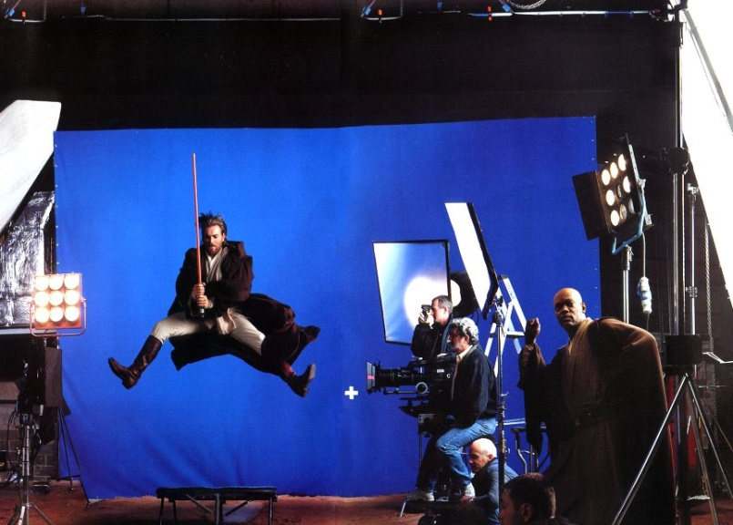
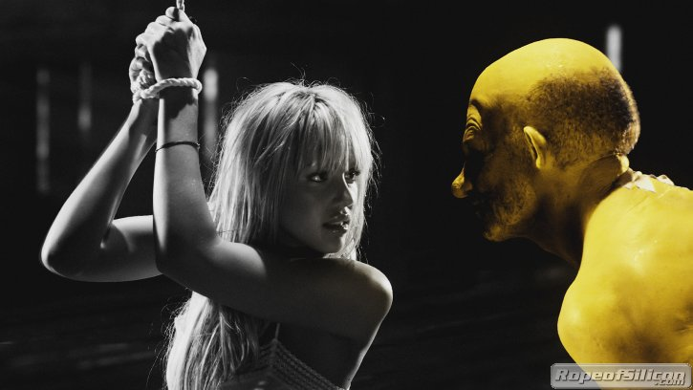
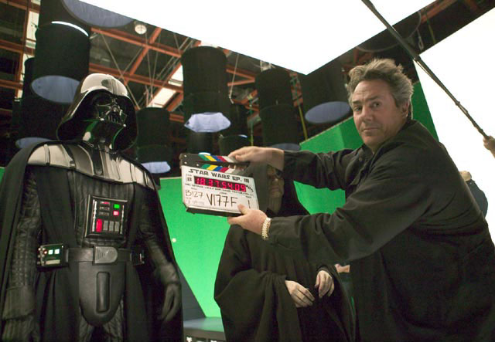
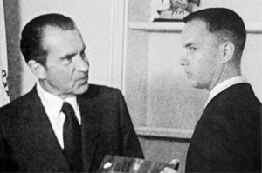
Examples: Artistic Effects
Artistic effects are used to make images more visually appealing, to add special effects and to make composite images

Slide 26
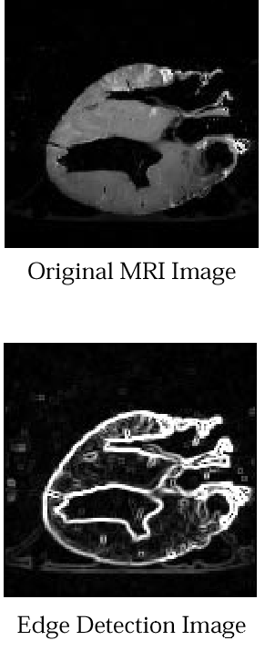
Examples: Medicine
Take slice from MRI scan of canine heart, and find boundaries between types of tissue
Image with gray levels representing tissue density
Use a suitable filter to highlight edges
Original MRI Image of a Dog Heart
Edge Detection Image

Slide 27
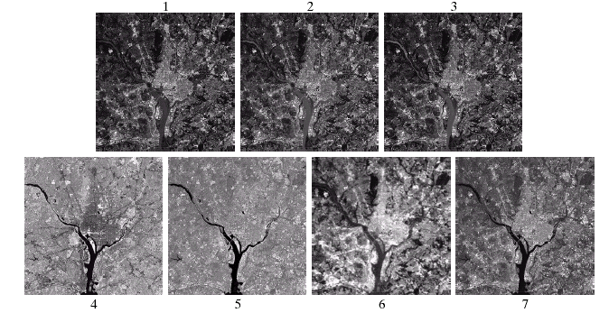
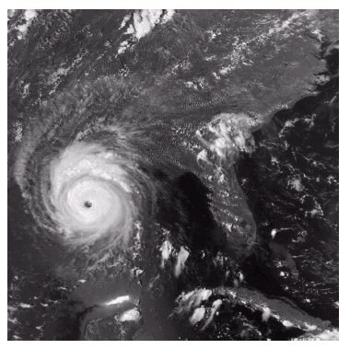
Examples: GIS
Geographic Information Systems
Digital image processing techniques are used extensively to manipulate satellite imagery
Terrain classification
Meteorology

Slide 28
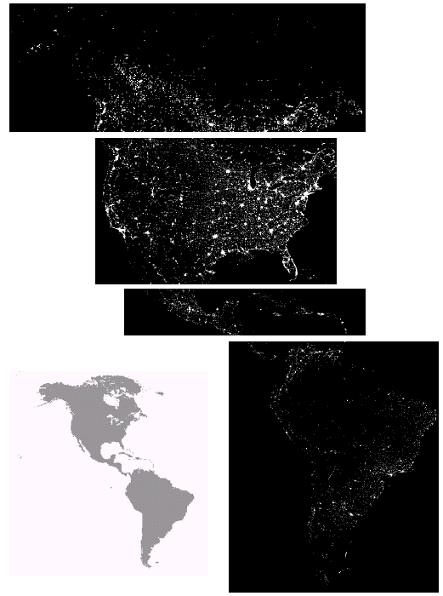
Examples: GIS (Cont…)
Night-Time Lights of the World data set
Global inventory of human settlement
Not hard to imagine the kind of analysis that might be done using this data

Slide 29
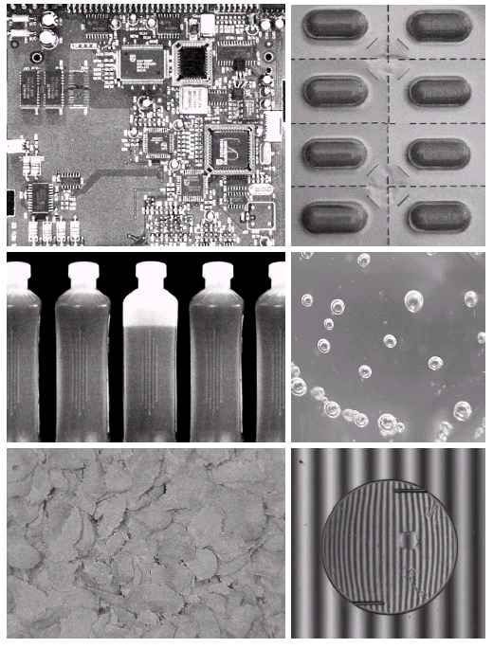
Examples: Industrial Inspection
Human operators are expensive, slow and unreliable
Make machines do the job instead
Industrial vision systems are used in all kinds of industries
Can we trust them?

Slide 30
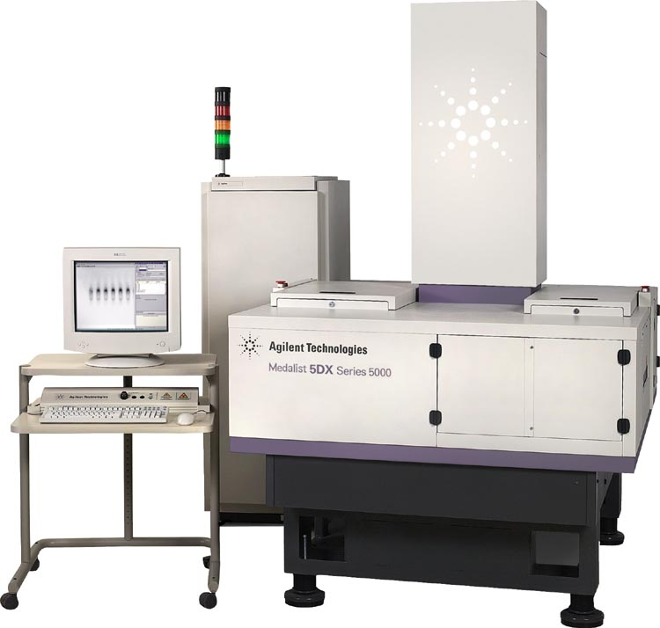
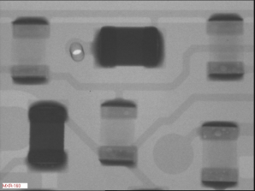
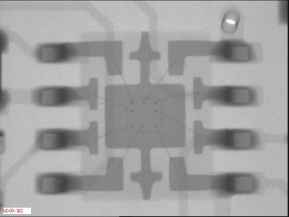
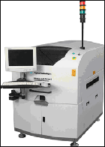
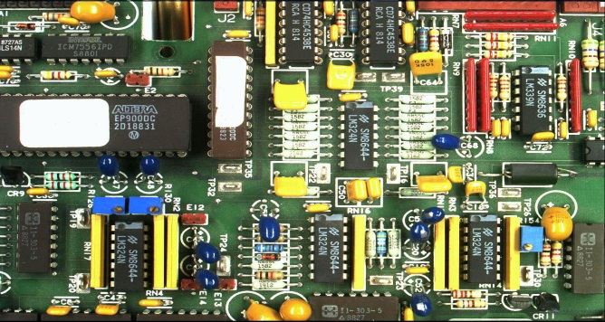
Examples: PCB Inspection
Printed Circuit Board (PCB) inspection
Machine inspection is used to determine that all components are present and that all solder joints are acceptable
Both conventional imaging and x-ray imaging are used

Slide 31
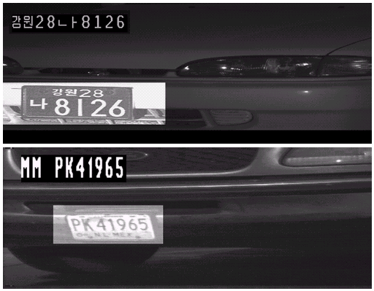
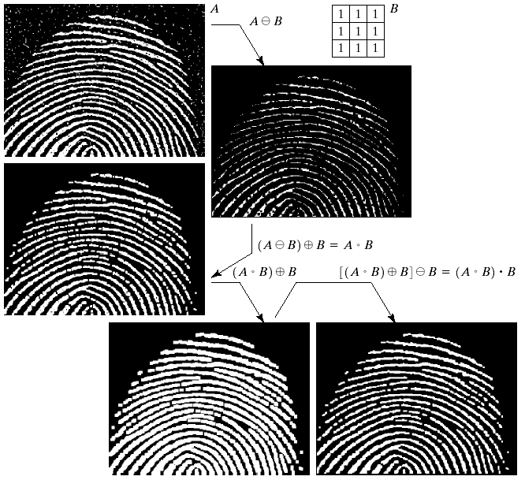
Examples: Law Enforcement
Image processing techniques are used extensively by law enforcers
Number plate recognition for speed cameras/automated toll systems
Fingerprint recognition
Enhancement of CCTV images

Slide 32
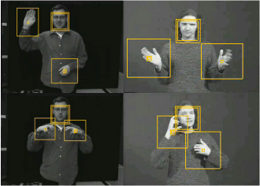
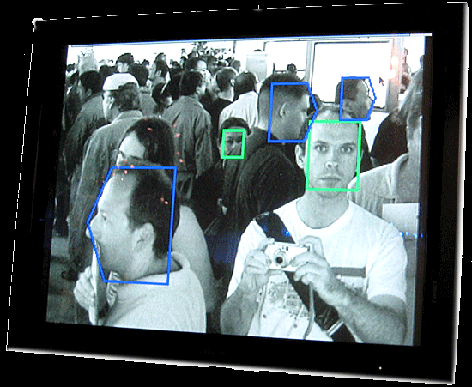
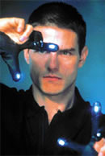
Examples: HCI
Try to make human computer interfaces more natural
Face recognition
Gesture recognition
Does anyone remember the user interface from “Minority Report”?
These tasks can be
extremely difficult

Slide 33
Key Stages in Digital Image Processing
Image Restoration
Morphological Processing
Image Enhancement
Segmentation
Image Acquisition
Object Recognition
Representation & Description
Problem Domain
Wavelet transforms
Colour Image Processing
Image Compression

Slide 34
Key Stages in Digital Image Processing
Image Restoration
Morphological Processing
Image Enhancement
Knowledge base / Problem Domain: Knowledge about the problem domain is coded into an image processing system in form of a knowledge database. Knowledge base can be simple or complex. Knowledge base also controls the interaction between modules.
Segmentation
Image Acquisition
Object Recognition
Representation & Description
Problem Domain
Wavelet transforms
Colour Image Processing
Image Compression

Slide 35
Key Stages in Digital Image Processing: Image Enhancement
Image acquisition is very first stage. Generally this stage involves preprocessing, such as scaling.
Image Restoration
Morphological Processing
Image Enhancement
Segmentation
Image Acquisition
Object Recognition
Representation & Description
Problem Domain
Wavelet transforms
Colour Image Processing
Image Compression

Slide 36
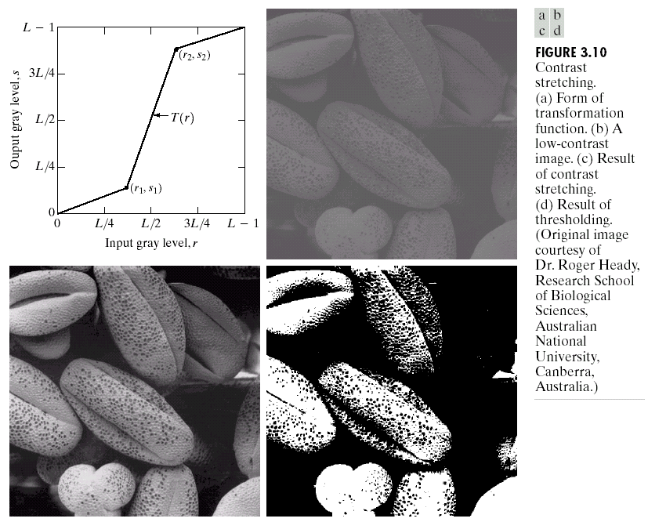
Key Stages in Digital Image Processing: Image Enhancement
Image Restoration
Morphological Processing
Image Enhancement
Segmentation
Image Acquisition
Object Recognition
Representation & Description
Problem Domain
Wavelet transforms
Colour Image Processing
Image Compression
Image enhancement is the process of manipulating an image so that the result is more suitable than the original for a specific application. This techniques are problem oriented (Subjective)

Slide 37
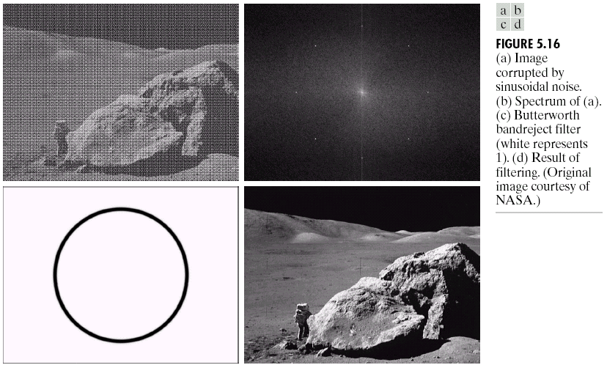
Key Stages in Digital Image Processing: Image Restoration
Image Restoration
Morphological Processing
Image Enhancement
Segmentation
Image Acquisition
Object Recognition
Representation & Description
Problem Domain
Wavelet transforms
Colour Image Processing
Image Compression
Image Restoration is an area that deals with improving the appearance of an image.

Slide 38
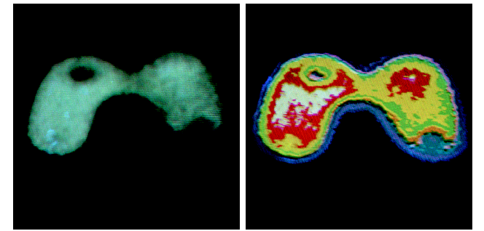
Key Stages in Digital Image Processing: Colour Image Processing
Color Image processing is gaining importance due to increase in use of digital images over internet.
Image Restoration
Morphological Processing
Image Enhancement
Segmentation
Image Acquisition
Object Recognition
Representation & Description
Problem Domain
Wavelet transforms
Colour Image Processing
Image Compression

Slide 39
Key Stages in Digital Image Processing: Wavelet transforms
Wavelets are the foundation for representing images in various degrees of solution, in which images are subdivided into smaller regions.
Image Restoration
Morphological Processing
Image Enhancement
Segmentation
Image Acquisition
Object Recognition
Representation & Description
Problem Domain
Wavelet transforms
Colour Image Processing
Image Compression

Slide 40
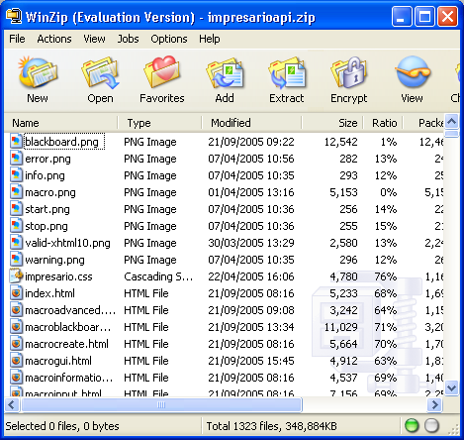
Key Stages in Digital Image Processing: Image Compression
Compression deals with the techniques for reducing the storage required to save an image. Jpg file extension is used over internet.
Image Restoration
Morphological Processing
Image Enhancement
Segmentation
Image Acquisition
Object Recognition
Representation & Description
Problem Domain
Wavelet transforms
Colour Image Processing
Image Compression

Slide 41
Key Stages in Digital Image Processing: Morphological Processing
Morphological processing deals with the tools for extracting image components that are useful in representation and description of the shape.
Image Restoration
Morphological Processing
Image Enhancement
Segmentation
Image Acquisition
Object Recognition
Representation & Description
Problem Domain
Wavelet transforms
Colour Image Processing
Image Compression

Slide 42
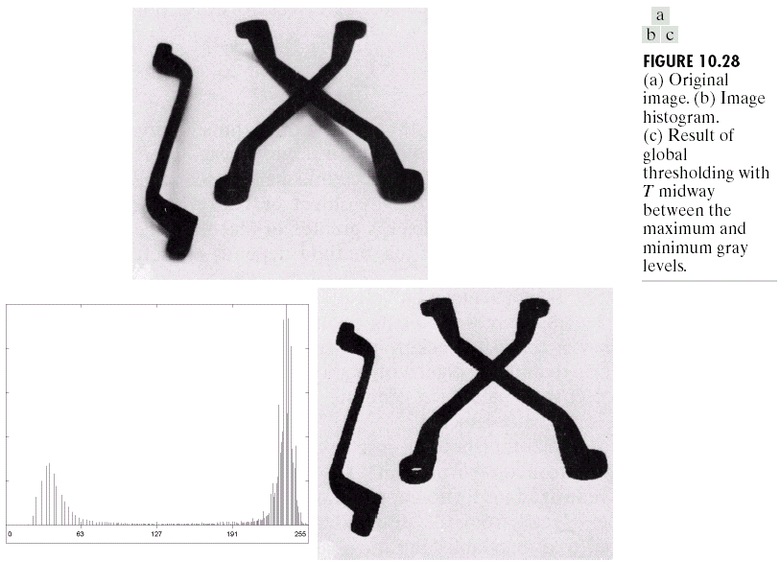
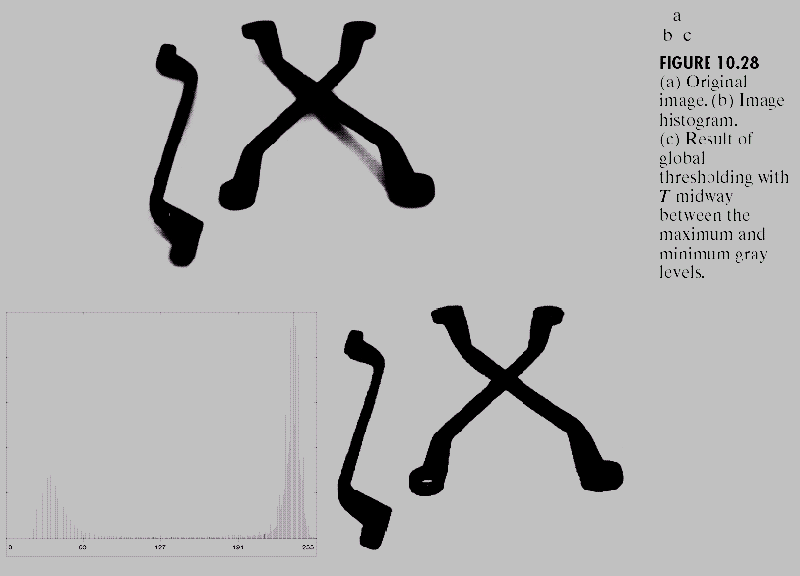
Key Stages in Digital Image Processing: Segmentation
Segmentation partition an image into its constituent parts or objects.
In general, the more accurate the segmentation, the more likely recognition is to succeed.
Image Restoration
Morphological Processing
Image Enhancement
Segmentation
Image Acquisition
Object Recognition
Representation & Description
Problem Domain
Wavelet transforms
Colour Image Processing
Image Compression

Slide 43
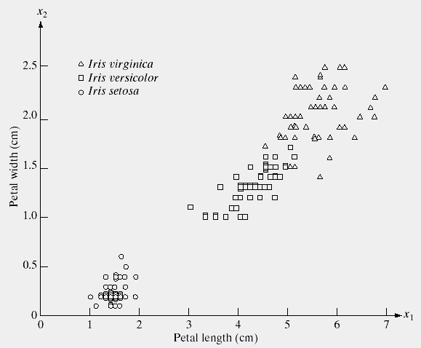
Key Stages in Digital Image Processing: Object Recognition
Recognition is the process that assigns a label to an object based on its descriptor.
Image Restoration
Morphological Processing
Image Enhancement
Segmentation
Image Acquisition
Object Recognition
Representation & Description
Problem Domain
Wavelet transforms
Colour Image Processing
Image Compression

Slide 44
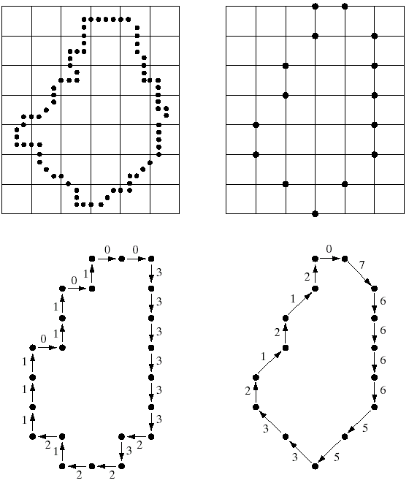
Key Stages in Digital Image Processing: Representation & Description
Representation and description almost always follows output of a segmentation stage.
Description also called feature selection which will extract attributes and result in some quantitative information.
Image Restoration
Morphological Processing
Image Enhancement
Segmentation
Image Acquisition
Object Recognition
Representation & Description
Problem Domain
Wavelet transforms
Colour Image Processing
Image Compression

Slide 45
Components of Image Processing System
Image Processing System is the combination of the different elements involved in the digital image processing.
Digital image processing is the processing of an image by means of a digital computer. Digital image processing uses different computer algorithms to perform image processing on the digital images.

Slide 46
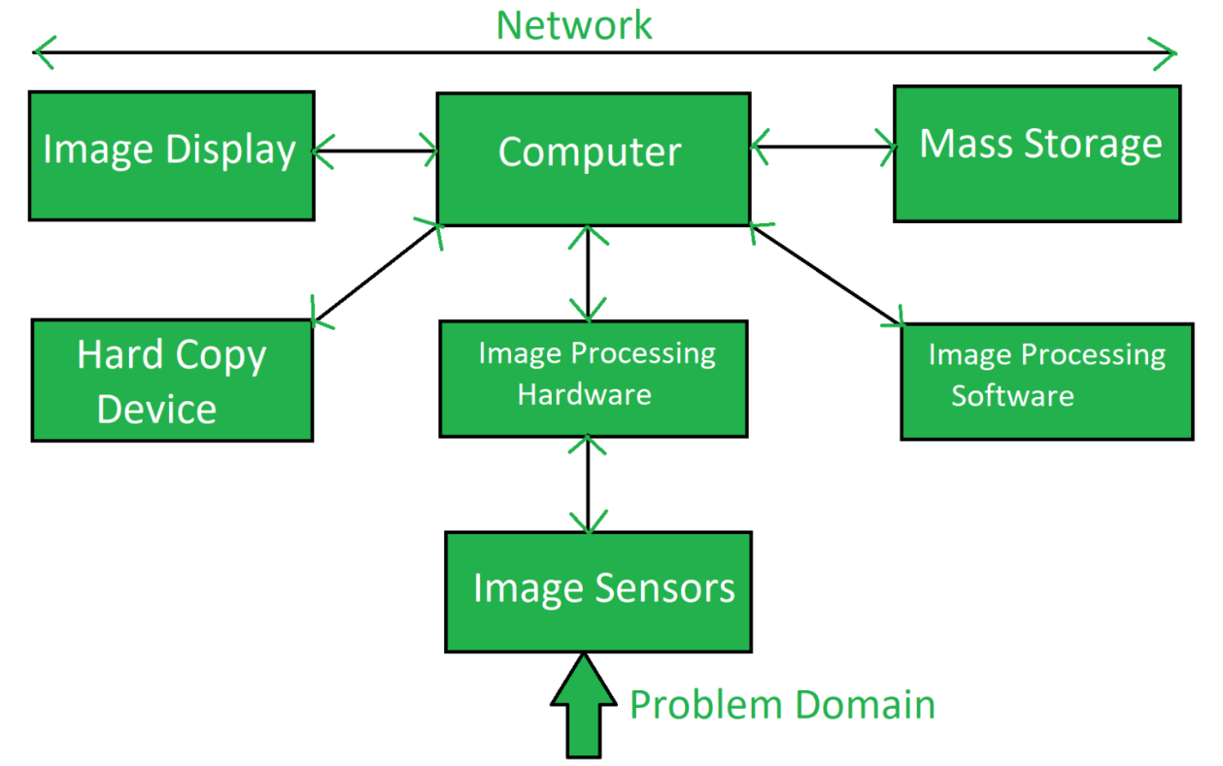
Components of Image Processing System (Cont.)
It consists of following components:-

Slide 47
Components of Image Processing System (Cont.)
Image Sensors:
Image sensors senses the intensity, amplitude, co-ordinates and other features of the images and passes the result to the image processing hardware. It includes the problem domain.
Image Processing Hardware:
Image processing hardware is the dedicated hardware that is used to process the instructions obtained from the image sensors. It passes the result to general purpose computer.
Computer:
Computer used in the image processing system is the general purpose computer that is used by us in our daily life.
Image Processing Software:
Image processing software is the software that includes all the mechanisms and algorithms that are used in image processing system.

Slide 48
Components of Image Processing System (Cont.)
Mass Storage:
Mass storage stores the pixels of the images during the processing.
Hard Copy Device:
Once the image is processed then it is stored in the hard copy device. It can be a pen drive or any external ROM device.
Image Display:
It includes the monitor or display screen that displays the processed images.
Network:
Network is the connection of all the above elements of the image processing system.

Slide 49
Types of Image Representation
BINARY IMAGE / BLACK AND WHITE IMAGE
The binary image as its name suggests, contain only two pixel elements
i.e 0 & 1,where 0 refers to black and 1 refers to white.
This image is also known as Monochrome.
The image which consist of only black and white color is called BLACK AND WHITE IMAGE.
Gray IMAGE / 8 bit COLOR FORMAT
It is the most famous image format.
It has 256 different shades of colors in it and commonly known as Grayscale Image.
In this format, 0 stands for Black, and 255 stands for white, and 127 stands for gray.
Color Image
16 bit COLOR FORMAT
It is a color image format. , It has 65,536 different colors in it. It is also known as High Color Format. In this format the distribution of color is not as same as Grayscale image.
24 bit COLOR FORMAT
It is a color image format. It has 2^24 different colors in it.It is also known as RGB Color Format.
In this format the distribution of color is not as same as Grayscale image.
Multispectral IMAGE
The Image contain the information outside the Normal Human perceptual range
This may include infrared, ultra violate, X-Rays, Radar Data or acoustic data

Slide 50
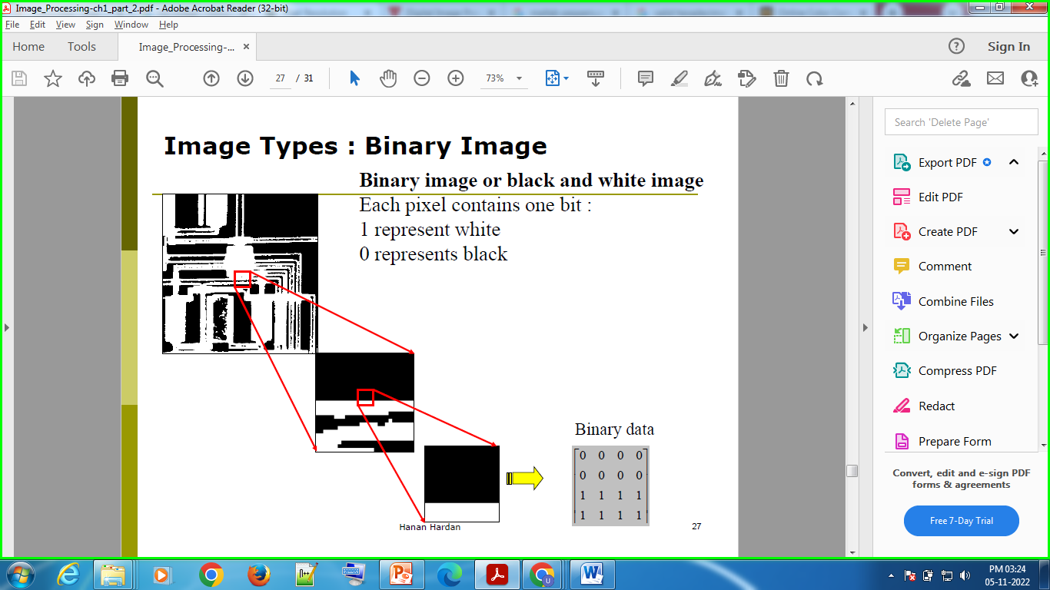
Types of Image Representation (Cont.)

Slide 51
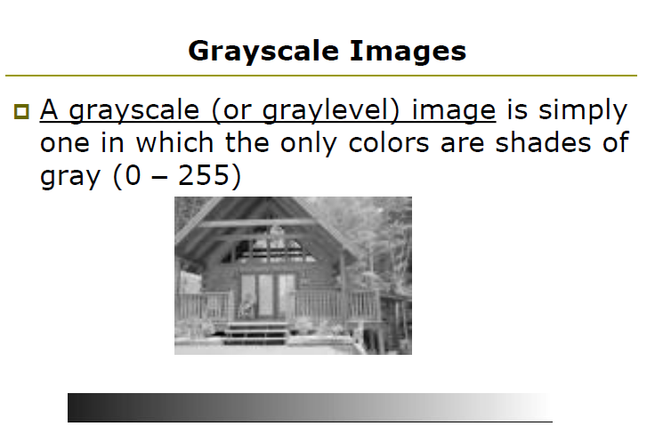
Types of Image Representation (Cont.)

Slide 52
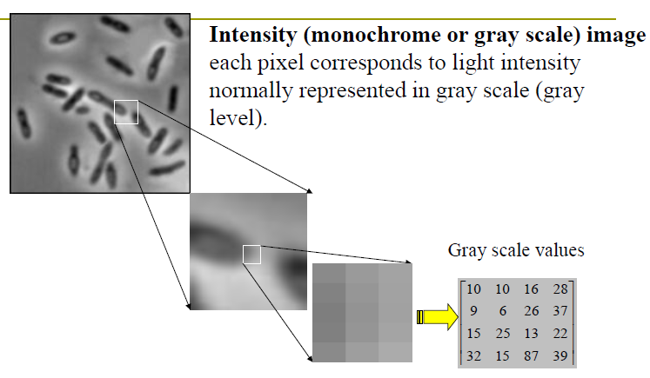
Types of Image Representation (Cont.)

Slide 53
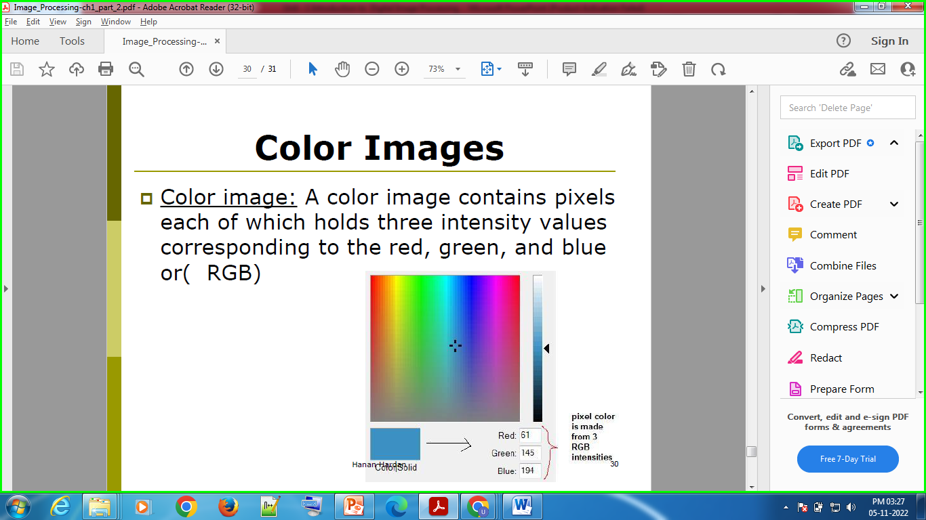

Types of Image Representation (Cont.)

Slide 54
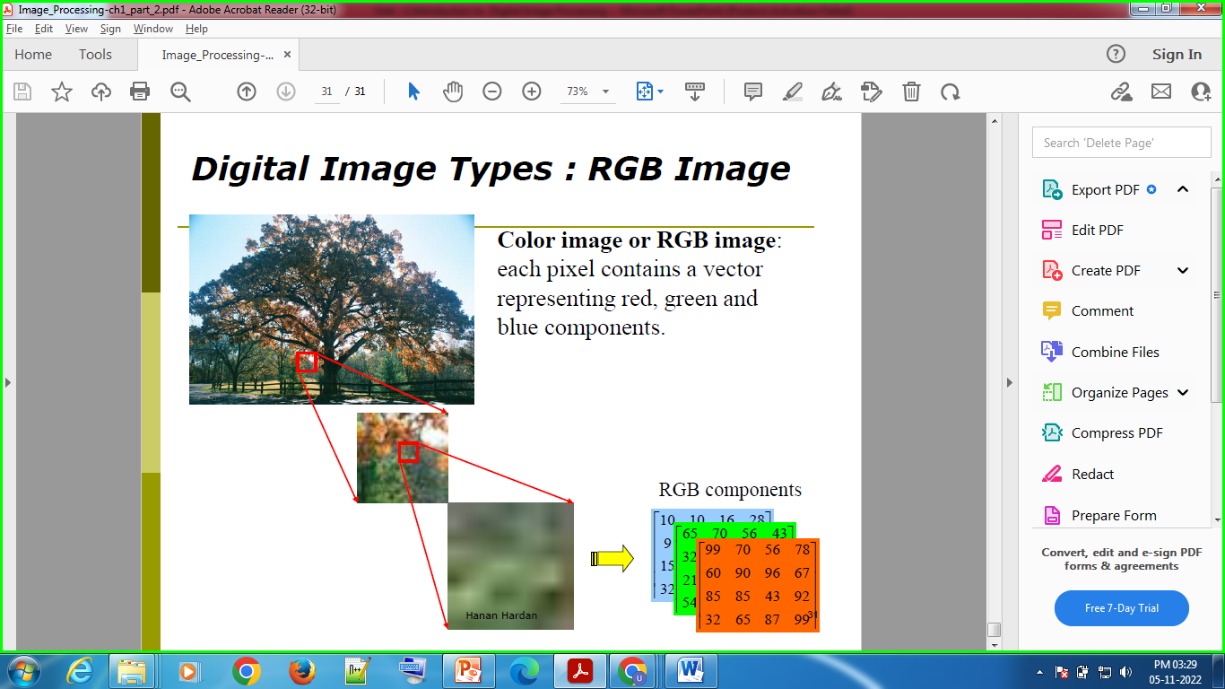
Types of Image Representation (Cont.)

Slide 55
Types of Image Representation (Cont.)
8 Bit Color Format
Known as Gray scale Image
Use to store Image Information
Range: 0 to 255
Red Bit – 3, Green Bit – 3 Blue Bit - 2
Used By: Unix OS
Extension: PGM (Portable Gray Map)
16 Bit Color Format
Known as High color Format
Red Bit – 5, Green Bit – 6 Blue Bit - 5
Range: 0 to 65535
Used By: Microsoft
24 Bit Color Format
True Color Format
Most common used Format
Red Bit – 8, Green Bit – 8 Blue Bit - 8
Extension: PPM (Portable PixMap) – for Linux , BMP (BitMap) – for Windows

Slide 56
Pixel & Bitmap
Pixel
In Computer graphics a pixel, dots, or picture element is a physical point in a picture.
A pixel is simply the smallest addressable element of a picture represented on a screen.
Bitmap
In computer graphics, a bitmap is a mapping from some domain (for example, a range of integers) to bits, that is, values which are zero or one.
It is also called a bit array or bitmap index.
The more general term pixmap refers to a map of pixels, where each one may store more than two colors, thus using more than one bit per pixel. Often bitmap is used for this as well.

Slide 57
Image file formats
Image file formats
Raster Graphics / Raster Image
Vector Graphics / vector Image

Slide 58
Raster Graphics VS Vector Graphics
Raster | Vector
Raster images are also known as Bitmap images and are made up of small dots known as pixels. | Vector images are made up of lines, fills, and curves.
In Raster, pixels of the same colour or different colour are placed close to each other so that the human eye perceives them as pictures but not as dots. | Vector images are collections of elements such as lines, rectangles, circles, and square. Each vector element has its own coordinates and can be resized.
Raster image knows the colour of each pixel. | The vector consists of instructions on where to place its components.
Raster has only two colours, black or white. With an increase in complexity, it can contain more colours. | Vectors use mathematical formulas in describing colours, shapes, and placement.
Raster images have a wide range of colour gradations and less scalable than Vector images. | Vector images are much more scalable than Raster images.

Slide 59
Raster Graphics VS Vector Graphics
Raster | Vector
File formats extension for raster: XBM, TIFF, PCX, and bitmap fonts .tif .tiff: Tagged Image File Format .jpg .jpeg: Joint Photographic Experts Group .psd: Photoshop Document .gif: Graphics Interchange Format .bmp: Bitmap image file .png: Portable Network Graphics XBM: X Bitmap Graphic file PCX: PiCture eXchange | File format extension for Vector:, PICT, WMF, PostScript, TrueType .eps: Encapsulated PostScript .ai: Adobe Illustrator Artwork .cdr: CorelDraw .svg: Scalable Vector Graphics .pdf: Portable Document Format
The conversion of raster to vector is time-consuming and based on complexity. | A vector image can be easily converted to a bitmap image.
Some of the raster programs include photo editing, Photoshop, GIMP, paint shop. | Vector programs include Illustrator, Inkscape, CorelDraw.
A kind of Raster file can be easily converted to another and high processing speed | Vectors are difficult to modify or display if not opened in programs that understand vector and having low processing Speed

Slide 60
Raster Graphics VS Vector Graphics
Raster | Vector
When the user paints a raster image, it looks similar to dipping brush in paint and painting images. | When the user paints a vector image, only the outline of the shape is painted. Similar to creating an image with different tiles of different shapes and sizes.
On enlarging a raster image without a change in pixel count, the image looks blurry. Enlarging file with increasing in pixel count, which may produce better results comparatively. | On enlarging a vector image, mathematical formulas remain the same, scalable to any size.
Raster programs are best suitable for photo editing, the creation of a continuous toned image with soft colour. | Vectors are best suitable for drawings, creating logos, illustrations, and technical drawings
A huge dimension and fair detailed image produce a large size of the image. | Vectors are resolution dependent, can be printed at any size or resolution.
Difficult to print raster images using limited spot colours. | In vector, the numbers of colours can be increased or decreased for printing.

Slide 61
Question
Digital Image is Raster Graphics or Vector Graphics ?

Slide 62
Digital Image
A digital image is a numeric representation (normally binary) of a two-dimensional image. Depending on whether the image resolution is fixed.
The term "digital image" usually refers to raster images or bitmapped images

Slide 63
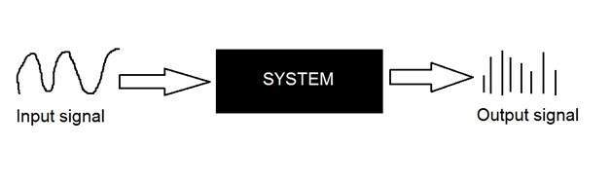
System
A system is a defined by the type of input and output it deals with.
The input is known as excitation and the output is known as response.
Analog Signal
Digital Signal

Slide 64
Conversion of Analog to Digital signals
There two main concepts that are involved in the conversion.
Sampling
Quantization

Slide 65
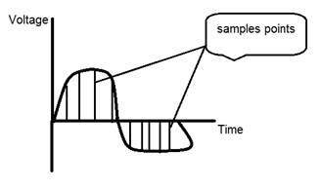
Sampling
Sampling as its name suggests can be defined as take samples.
Take samples of a digital signal over x axis.
Sampling is done on the x variable.

Slide 66
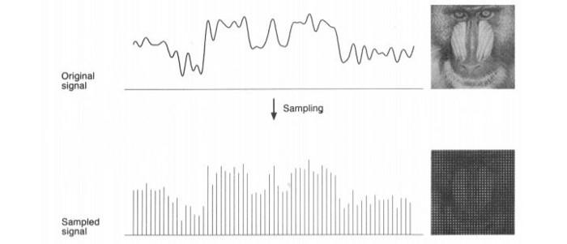
Sampling (Cont.)

Slide 67
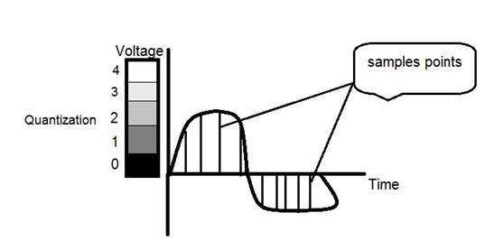
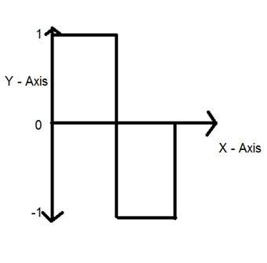
Quantization
Quantization as its name suggest can be defined as dividing into quanta (partitions).
It is opposite to sampling.
Sampling is done on the x variable.

Slide 68
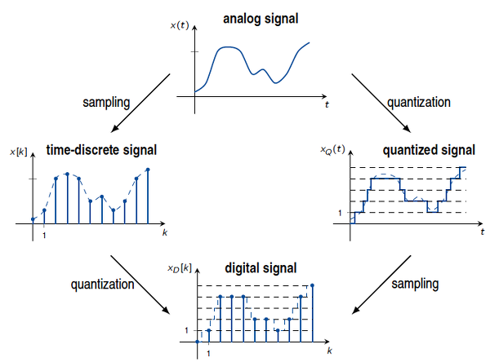
Sampling VS Quantization

Slide 69
Concept of Bits Per Pixel
BBP – Bits per Pixel
It is used to denote the no of bits per Pixel
No. of Colors or Shades = 2^{BPP}

Slide 70
Concept of Bits Per Pixel (Cont.)
Suppose a pixel has 1 bit, how many no of color that Image have?
Answer:
2 intensity levels only, black and white.
No. of Colors or Shades = 2^{BPP} = 2¹ = 2
Bit (0,1)
0:black
1: white

Slide 71
Concept of Bits Per Pixel (Cont.)
Suppose a pixel has 2 bit, how many gray levels can it represent?
Answer:
4 gray intensity levels
No. of Colors or Shades = 2^{BPP} = 2² = 4
2 Bit So Combinations - (00, 01, 10 ,11).

Slide 72
Concept of Bits Per Pixel (Cont.)
Suppose if we want to represent 256 No of Colors, how many bits do we need?
Answer:
No. of Colors or Shades = 2^{BPP} = 2⁸ = 256
8 bits are required

Slide 73
Image Size / Number of storage of bits
Image Size = No. of Rows * No. of Cols. * BPP
Example: Rows : 3000, Col.: 1687, Shades: 256, Find the Size of Image
No. of Colors or Shades = 2^{BPP} = 2⁸ = 256
BPP = 8
Image Size = No. of Rows * No. of Cols. * BPP
= 3000 * 1687 * 8
= 40488000 bits
= 40488000 / 8 Byte = 5061000 Byte
= 5061000 / 1024 KB = 4942 KB
= 4942 / 1024 MB = 4 MB

Slide 74
Image Size / Number of storage of bits (Cont.)
Image Size = No. of Rows * No. of Cols. * BPP
Example: Rows : 1024, Col.: 1024 , BPP = 8, Find the Size of Image
Image Size = No. of Rows * No. of Cols. * BPP
= 1024 * 1024 * 8
= 8388608 bits
= 8388608 / 8 Byte = 1048576 Byte
= 1048576 / 1024 KB = 1024 KB
= 1024 / 1024 MB = 1 MB

Slide 75
Color Code Conversion
Binary Color Format
Black – RGB (0 , 0 , 0)
While – RGB (255 , 255 , 255)
Gray Color Format
Gray– RGB (127, 127 , 127)
RGB Color Format (Red, Green, Blue)
Red– RGB (255 , 0 , 0)
Green– RGB (0, 255 , 0)
Blue– RGB (0, 0 , 255)
CMYK Color Format (Cyan, Magenta, Yellow, Black)
Cyan– RGB (0 , 255 , 255)
Magenta– RGB (255, 0 , 255)
Yellow– RGB (255, 255 , 0)
HSI Color Format (Hue, Saturation, Intensity)

Slide 76
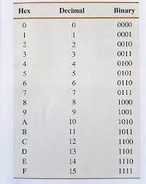
RGB to Hex Code Conversion
RGB | Hex
(255, 255, 255) | #FFFFFF
(255, 0 , 255) | #FF00FF
(255, 255, 0) | #FFFF00
(0, 255, 255) | #00FFFF
(0, 0 , 0) | #000000
(127 , 127 , 127) | #7F7F7F
(128 , 128 , 128) | #808080
(190 , 121 , 163) | #BE79A3
(201 , 182 , 95) | #C9B65F

Slide 77
Grayscale to RGB Conversion
To convert a grayscale image into color or RGB format, we have two methods.
Average method
Weighted method or luminosity method

Slide 78


Average Method
It is the simplest method. We have to take an average of all the 3 colors.
Formula: (R + G + B)/3
Explanation
As we can see, there are
changes in the image by
applying the average method.
But the result is unexpected
as we want a grayscale image,
but it turned to be a black image.

Slide 79
Average Method (Cont.)
Problem
This problem occurs because we have taken an average of 3 colors.
All the 3 colors have different wavelength and have their contribution to the formation of an image. In the above image, we are taking 33% from each portion that is why the image does not occur in grayscale.
The solution to this problem is given by the weighted method.

Slide 80
Weighted Method or luminosity Method
As we have seen the problem in the average method. And for this problem weight method is the solution.
In all the 3 portions of color, red color has more wavelength, and green color has less wavelength. But green color gives a more soothing effect to the eyes as compared to red color.
By decreasing the value of red color and increasing the value of green color and the value for blue color will be between these two colors.
The equation for a new grayscale image will be:

Slide 81


Weighted Method or luminosity Method (Cont.)
According to the above equation, red is used 30%, green is used 59%, and blue is used 11%. The contribution of green is highest.
By Applying the equation in an image, we will get:
Explanation
As we can see using the
weighted method the image
is properly converted into
grayscale. Image is brighter as
compared with the image
which was generated using
the average method.

Slide 82
Some basic Relationships between Pixels
Relationships between pixels
Neighbors of a Pixel
4-neighbours of p
4-horizontal/vertical neighbours of p : N₄(p).
Diagonal-neighbours of p : N_{D}(p)
8-neighbours of p: N₈(p)
Adjacency
4-Adjacency
8-Adjacency
Connectivity
Regions and boundaries

Slide 83

Neighbors of a Pixel
4-neighbours of p
4-horizontal/vertical neighbours of p : N₄(p)
A pixel p at (x,y) has 4-horizontal/vertical neighbours at (x+1,y), (x-1,y), (x,y+1) and (x,y-1).
Diagonal-neighbours of p : N_{D}(p)
A pixel p at (x,y) has 4 diagonal neighbours at (x+1,y+1), (x+1,y-1), (x-1,y+1) and (x-1,y-1).

Slide 84

Neighbors of a Pixel
8-neighbours of p
The 4-neighbours and the diagonal neighbours of p are called 8-neighbours of p : N₈(p).
A pixel p at (x,y) has 4-horizontal/vertical neighbours at (x+1,y), (x-1,y), (x,y+1), (x,y-1) + 4 diagonal neighbours at (x+1,y+1), (x+1,y-1), (x-1,y+1) , (x-1,y-1).

Slide 85

Adjacency
V: set of gray level values (L), (V is a subset of L.)
4- adjacency: 2 pixels p and q with values from V are 4- adjacent if q is in the set N₄(p)
8- adjacency: 2 pixels p and q with values from V are 8- adjacent if q is in the set N₈(p)

Slide 86
Connectivity
Two pixels p and q are said to be connected in S if there exists a path between them consisting entirely of pixels in S.

Slide 87
Regions and boundaries
Region
Let R be a subset of pixels in an image, we call R a region of the image if R is a connected set.
Boundary
The boundary (also called border or contour) of a region R is the set of pixels in the region that have one or more neighbors that are not in R.

Slide 88
Distance Measures
If we have 3 pixels: p,q,z respectively
p with (x,y)
q with (s,t)
z with (v,w)
Then:
D (p,q) ≥ 0 ,D(p,q) = 0 iff p = q
D(p,q) = D(q,p)
D(p,z) ≤ D(p,q) + D(q,z)

Slide 89
Distance Measures (Cont.)
Euclidean Distance: D_{e}(p,q)
City-Block Distance : D₄(p,q) = |x-s| + |y-t|
Chessboard Distance) D₈(p,q) = max (|x-s| , |y-t|)
D_{m} Distance
It is Defined as a shortest m=path between pointes.
In this case, the distance between two pixels will depend on the values of the pixels along the path, as well as the values of their neighbors.

Slide 90

Distance Measures (Cont.)

Slide 91

Distance Measures (Cont.)
Example: Compute Euclidian distance , City Block distance and chessboard distance between the two pixels using the three distances
Answer:
q:(1,1)
P: (2,2)
Euclidian distance : ((1-2)2+(1-2)2)1/2 = sqrt(2).
D4(City Block distance): |1-2| +|1-2| =2
D8(chessboard distance ) : max(|1-2|,|1-2|)= 1

Slide 92

Distance Measures (Cont.)

